Slide 1




Streams and Files
File Types, Using Streams, Manipulating Files
Advanced
C#
SoftUni Team
Technical Trainers
Software University
http://softuni.bg

Slide 2

Table of Contents
Readers and Writers
What are Streams?
Stream Basics
Stream Types
File, Memory, Network Streams
Crypto, Gzip Streams

Slide 3
Questions
sli.do #CSharp-Fund

Slide 4

What Is a Stream?
Basic Concepts

Slide 5


What is a Stream?
Streams are used to transfer data
We open a stream to:
Read data
Write data
1100 1001 1001
Stream
Notes:
Icons by Chanut is Industries / Pixel perfect at http://www.flaticon.com/

Slide 6
Stream Basics
Streams are means for transferring (reading and writing) data
Streams are ordered sequences of bytes
Provide sequential access to its elements
Different types of streams are available to access different data sources:
File access, network access, memory streams and others
Streams are opened before using them and closed after that

Slide 7
Stream – Example
Length = 9
Position is the current position in the stream
Buffer keeps n bytes of the stream from the current position
F i l e s a n d
46 | 69 | 6c | 65 | 73 | 20 | 61 | 6e | 64
Position
Buffer
46 | 69
6c | 65
73 | 20
61 | 6e
64

Slide 8

Readers and Writers

Slide 9
Readers and Writers
Readers and writers are classes which facilitate the work with streams
Two types of streams
Text readers/writers – StreamReader / StreamWriter
Provide methods .ReadLine(), .WriteLine() (similar to working with Console.*)
Binary readers/writers – BinaryReader / BinaryWriter
Provide methods for working with primitive types – .ReadInt32(), .ReadBoolean(), WriteChar(), etc.

Slide 10
Problem: Read File
Read all content from your Program.cs file
Print it to the console with line numbers
using System;
using System.IO;
class Program
{
Line 1: using System;
Line 2: using System.IO;
Line 3:
Line 4: class Program
Line 5: {

Slide 11
Solution: Read File
StreamReader reader = new StreamReader("somefile.txt");
using (reader)
{
int lineNumber = 0;
string line = reader.ReadLine();
while (line != null)
{
lineNumber++;
Console.WriteLine("Line {0}: {1}", lineNumber, line);
line = reader.ReadLine();
}
}

Slide 12
Problem: Write to File
Read your Program.cs file
Reverse each line of the file
Save it in reversed.txt
using System.IO;
class Program
{
;OI.metsyS gnisu
margorP ssalc
{

Slide 13
Writing Reversed Text to File – Example
using (var reader = new StreamReader("../../Program.cs"))
{
using (var writer = new StreamWriter("../../reversed.txt"))
{
string line = reader.ReadLine();
while (line != null)
{
for (int i = line.Length - 1; i >= 0; i--)
{
writer.Write(line[i]);
}
writer.WriteLine();
line = reader.ReadLine();
}
}
}

Slide 14

Base Streams
File, Memory, Network

Slide 15
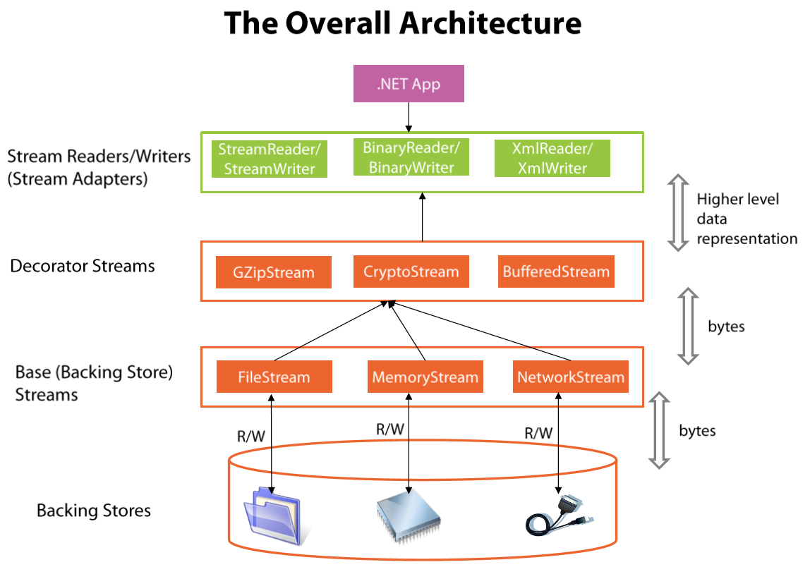
Stream Types in .NET

Slide 16
The System.IO.Stream Class
The base class for all streams is System.IO.Stream
There are defined methods for the main operations with streams in it
Some streams do not support read, write or positioning operations
Properties CanRead, CanWrite and CanSeek are provided
Streams which support positioning have the properties Position and Length

Slide 17
Methods of System.IO.Stream Class
int Read(byte[] buffer, int offset, int count)
Read as many as count bytes from input stream, starting from the given offset position
Returns the number of read bytes or 0 if end of stream is reached
Can freeze for undefined time while reading at least 1 byte
Can read less than the claimed number of bytes
F i l e s a n d
46 | 69 | 6c | 65 | 73 | 20 | 61 | 6e | 64

Slide 18
Methods of System.IO.Stream Class (2)
Write(byte[] buffer, int offset, int count)
Writes a sequence of count bytes to an output stream, starting from the given offset position
Can freeze for undefined time, until it sends all bytes to their destination
Flush()
Sends the internal buffers data to its destination (data storage, I/O device, etc.)

Slide 19
Methods of System.IO.Stream Class (3)
Close()
Calls Flush()
Closes the connection to the device (mechanism)
Releases the used resources
Seek(offset, SeekOrigin) – moves the position (if supported) with given offset towards the beginning, the end or the current position

Slide 20



File Stream

Slide 21
The FileStream Class
Inherits the Stream class and supports all its methods and properties
Supports reading, writing, positioning operations, etc.
The constructor contains parameters for:
File name
File open mode
File access mode
Concurrent users access mode

Slide 22
The FileStream Class (2)
FileMode – opening file mode
Open, Append, Create, CreateNew, OpenOrCreate,Truncate
FileAccess – operations mode for the file
Read, Write, ReadWrite
FileShare – access rules for other users while file is opened
None, Read, Write, ReadWrite
FileStream fs = new FileStream(string fileName, FileMode
[,FileAccess [, FileShare]]);
Optional parameters

Slide 23
Writing Text to File – Example
string text = "Кирилица";
var fileStream = new FileStream("../../log.txt",
FileMode.Create);
try
{
byte[] bytes = Encoding.UTF8.GetBytes(text);
fileStream.Write(bytes, 0, bytes.Length);
}
finally
{
fileStream.Close();
}
try-finally guarantees the stream will always close
Encoding.UTF8.GetBytes() returns the underlying bytes of the character

Slide 24
Copying File – Example
using (var source = new FileStream(SheepImagePath, FileMode.Open))
{
using (var destination =
new FileStream(DestinationPath, FileMode.Create))
{
while (true)
{
int readBytes = source.Read(buffer, 0, buffer.Length);
if (readBytes == 0)
break;
destination.Write(buffer, 0, readBytes);
}
}
}
using automatically closes the stream

Slide 25



Memory Stream

Slide 26
Reading In-Memory String – Example
string text = "In-memory text.";
byte[] bytes = Encoding.UTF8.GetBytes(text);
using (var memoryStream = new MemoryStream(bytes))
{
while (true)
{
int readByte = memoryStream.ReadByte();
if (readByte == -1)
break;
Console.WriteLine((char) readByte);
}
}

Slide 27
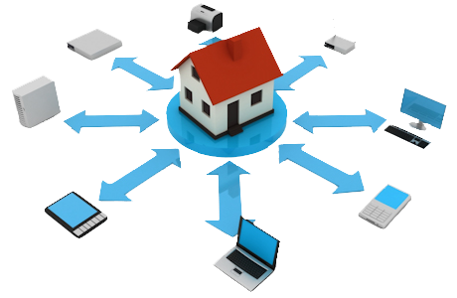
Network Stream

Slide 28
Simple Web Server – Example
var tcpListener = new TcpListener(IPAddress.Any, PortNumber);
tcpListener.Start();
Console.WriteLine("Listening on port {0}...", PortNumber);
while (true)
{
using (NetworkStream stream = tcpListener.AcceptTcpClient().GetStream())
{
byte[] request = new byte[4096];
stream.Read(request, 0, 4096);
Console.WriteLine(Encoding.UTF8.GetString(request));
string html = string.Format("{0}{1}{2}{3} - {4}{2}{1}{0}",
"<html>", "<body>", "<h1>", "Welcome to my awesome site!", DateTime.Now);
byte[] htmlBytes = Encoding.UTF8.GetBytes(html);
stream.Write(htmlBytes, 0, htmlBytes.Length);
}
}
Gets the stream
Reads request
Writes response

Slide 29
Buffered Streams
Buffer the data and effectively increase performance
Call for read of even 1 byte makes read of more kilobytes in advance
The stream keeps them in an internal buffer
Next read returns data from the internal buffer
Very fast operation

Slide 30
Buffered Streams (2)
Written data is stored in internal buffer
Very fast operation
When buffer overloads:
Flush() is called
The data is sent to its destination
In .NET we use the System.IO.BufferedStream class

Slide 31




Other Streams
.NET supports special streams
Work just like normal streams, but provide additional functionality
E.g. CryptoStream encrypts when writing, decrypts when reading
GzipStream compresses/decompresses data
PipedStream allows reading/writing data across multiple processes
Input Stream
Output Stream

Slide 32

Other Streams
Live Demo

Slide 33

Summary
Streams are ordered sequences of bytes
Serve as I/O mechanisms
Can be read or written to (or both)
Can have any nature – file, network, memory,
device, etc.
Reader and writers facilitate the work with streams by providing additional functionality (e.g. reading entire lines at once)
Always close streams by putting using(…) or try-finally

Slide 34







Streams and Files
https://softuni.bg/courses/csharp-advanced

Slide 35
License
This course (slides, examples, demos, videos, homework, etc.) is licensed under the "Creative Commons Attribution-NonCommercial-ShareAlike 4.0 International" license
Attribution: this work may contain portions from
"Fundamentals of Computer Programming with C#" book by Svetlin Nakov & Co. under CC-BY-SA license
"C# Part I" course by Telerik Academy under CC-BY-NC-SA license
"C# Part II" course by Telerik Academy under CC-BY-NC-SA license

Slide 36





Trainings @ Software University (SoftUni)
Software University – High-Quality Education, Profession and Job for Software Developers
softuni.bg
Software University Foundation
http://softuni.foundation/
Software University @ Facebook
facebook.com/SoftwareUniversity
Software University Forums
forum.softuni.bg

